Slide 1


Introducing AWS DeepRacer
Pravin

Slide 2
Agenda
Machine learning on AWS
Introducing AWS DeepRacer
Reinforcement learning for the Sunday driver
The AWS DeepRacer console
Training observation

Slide 3

Machine learning on AWS

Slide 4





























The AWS ML Stack
Broadest and most complete set of machine learning capabilities
AI SERVICES
HEALTH AI INDUSTRIAL AI
ANOMALY DETECTION
CODE AND DEVOPS
NEW
Amazon HealthLake
Amazon Transcribe Medical
Amazon Comprehend Medical
NEW
AWS Panorama
+ Appliance
NEW
Amazon Monitron
NEW
Amazon Lookout for Equipment
NEW
Amazon Lookout for Vision
NEW
Amazon Lookout for Metrics
NEW
Amazon DevOps Guru
Amazon CodeGuru
VISION
SPEECH
TEXT
SEARCH
CHATBOTS
PERSONALIZATION
FORECASTING
FRAUD
CONTACT CENTERS
Amazon Rekognition
Amazon Polly
Amazon Transcribe
+Medical
Amazon Comprehend
+Medical
Amazon Translate
Amazon Textract
Amazon Kendra
Amazon Lex
Amazon Personalize
Amazon Forecast
Amazon Fraud Detector
Contact Lens
Voice ID
For Amazon Connect
ML SERVICES
SAGEMAKER STUDIO IDE
Label data
NEW
Aggregate &
prepare data
NEW
Store & share
features
Auto ML
Spark/R
NEW
Detect
bias
Visualize in notebooks
Pick algorithm
Train models
Tune parameters
NEW
Debug &
profile
Deploy in production
Manage & monitor
NEW
CI/CD
Human review
Amazon
SageMaker
NEW: SageMaker JumpStart
NEW: Model management for edge devices
FRAMEWORKS & INFRASTRUCTURE
Deep Learning AMIs & Containers
GPUs & CPUs
Elastic Inference
Trainium
Inferentia
FPGA
DeepGraphLibrary

Slide 5
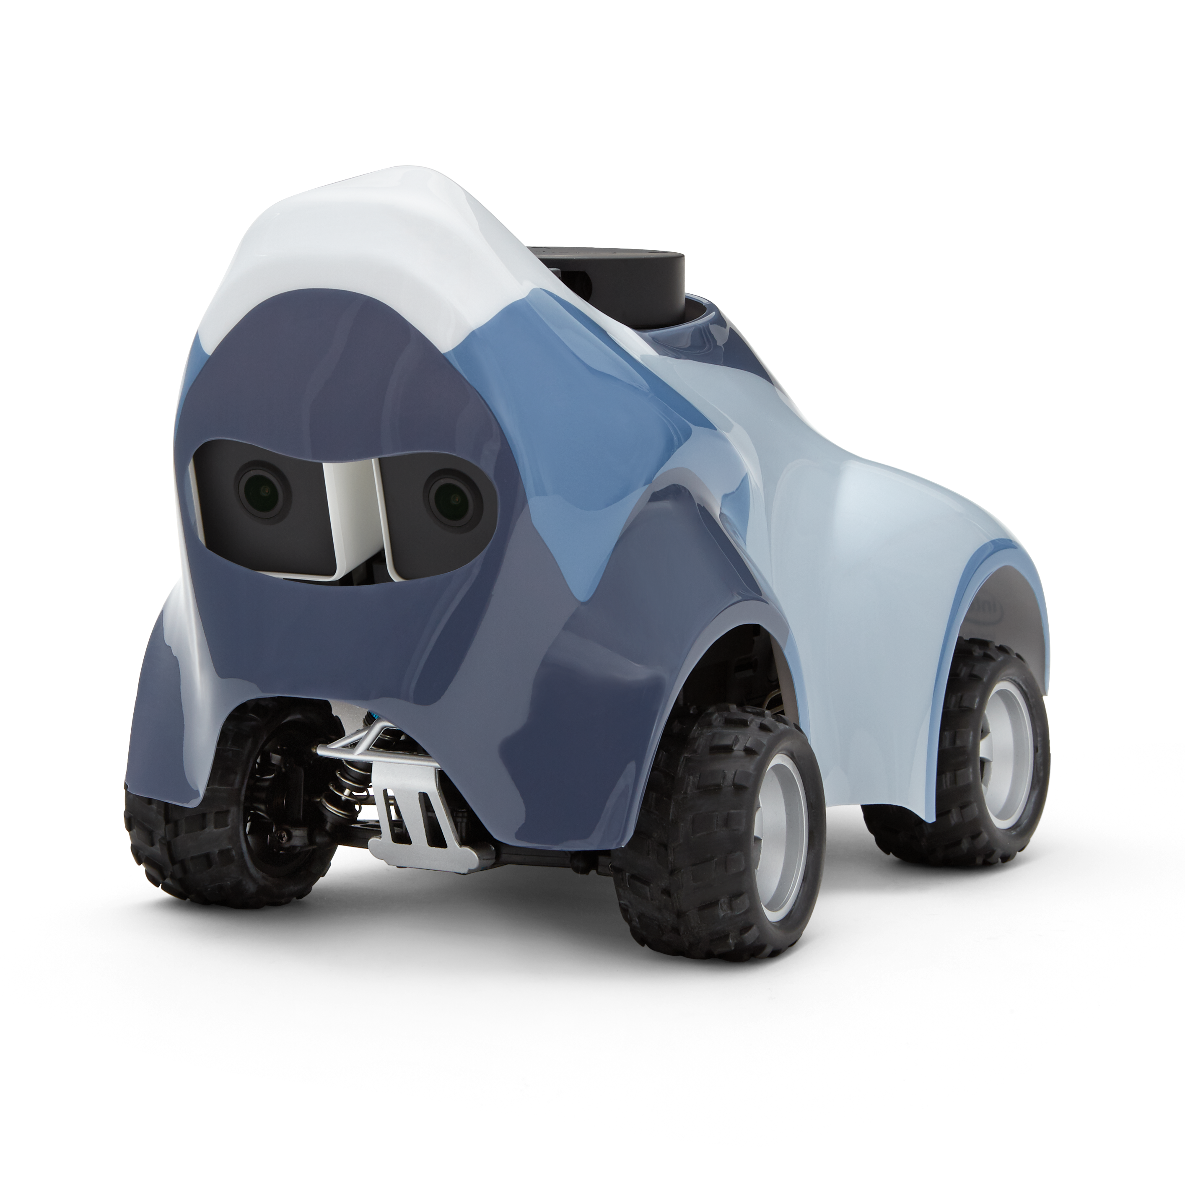
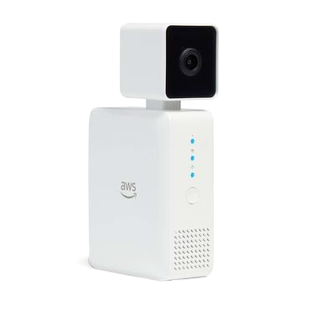
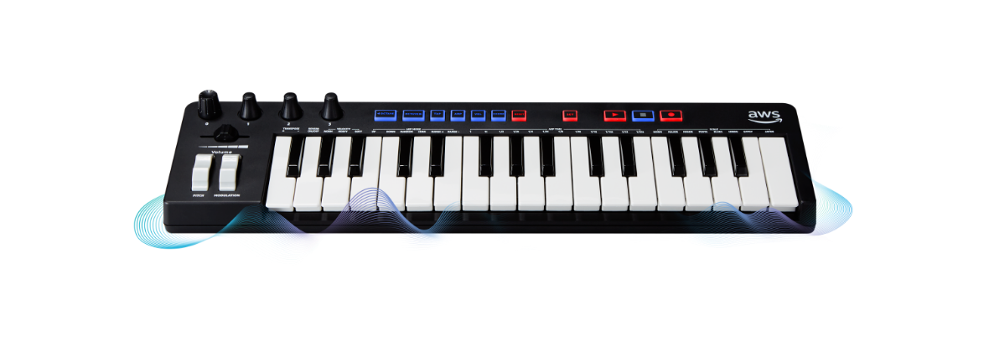
Building your team’s skills
Hands-on learning
AWS DeepLens Computer Vision
AWS DeepRacer Reinforcement learning
AWS DeepComposer Generative AI
© 2021, Amazon Web Services, Inc. or its Affiliates.

Slide 6

Introducing AWS DeepRacer

Slide 7
How can we put reinforcement learning in the hands
of all developers?
Literally

Slide 8
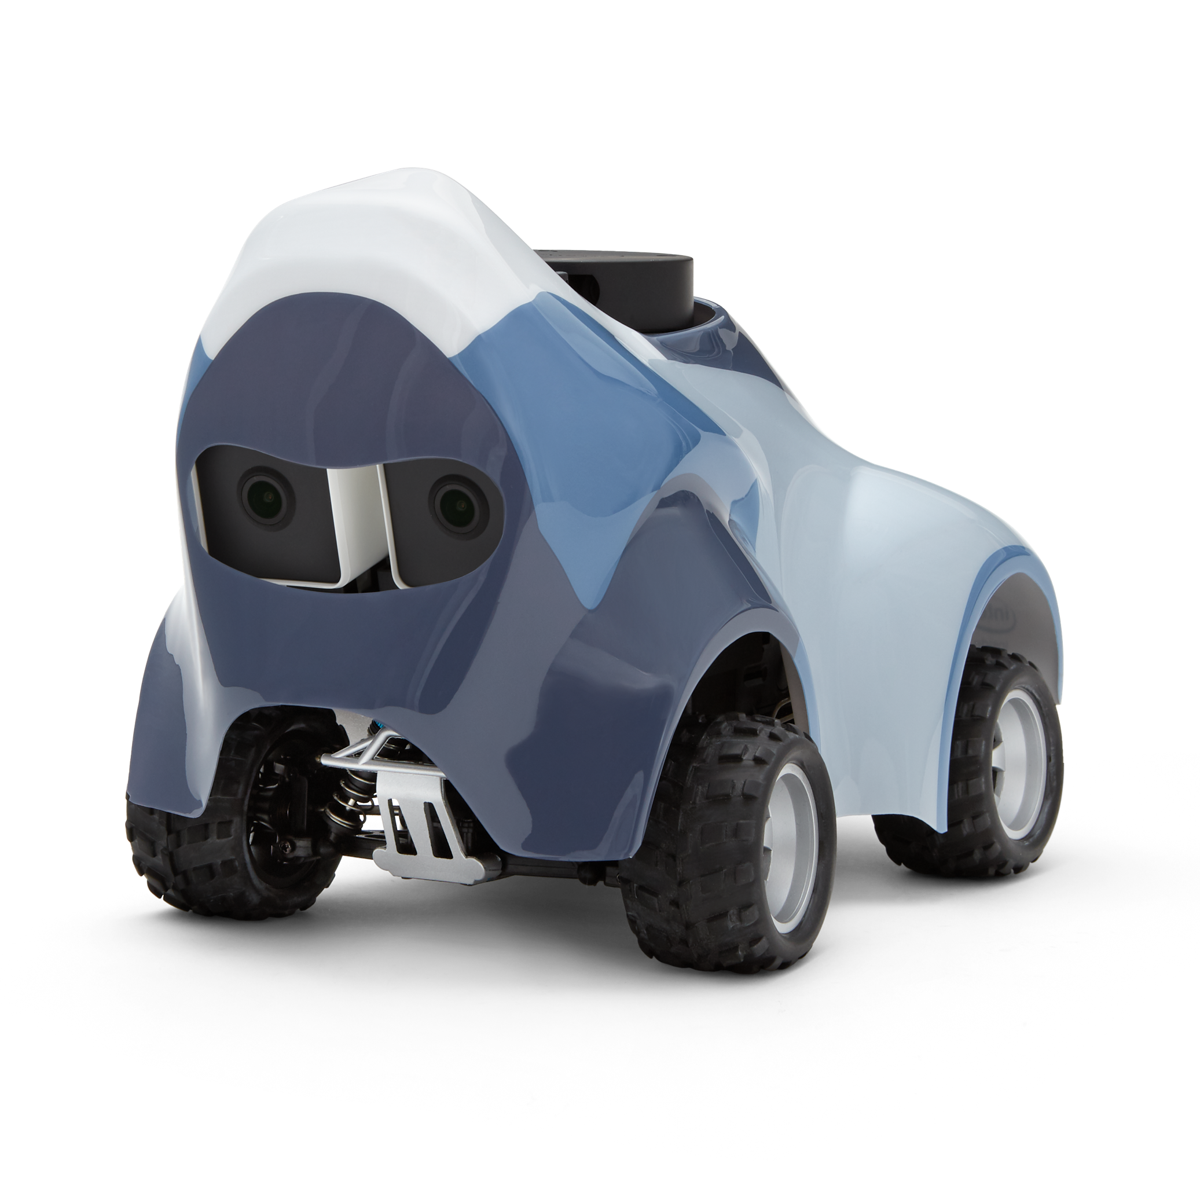

Under the hood
1:18 4WD scale car
Intel Atom processor
Intel distribution of OpenVINO toolkit
Stereo Camera (4MP)
360-degree 12-meter scanning radius LIDAR sensor
System memory: 4 GB RAM
802.11ac Wi-Fi
Ubuntu 20.04 LTS
ROS2 foxy

Slide 9


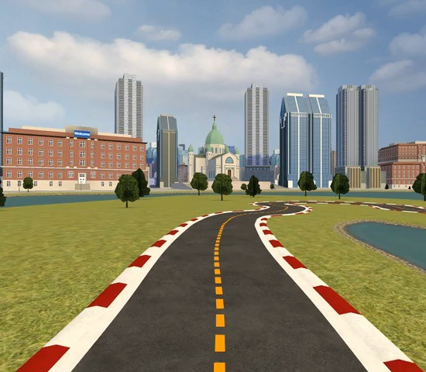
Get hands-on experience with reinforcement learning
AWS DeepRacer Evo
3D-racing simulator
AWS DeepRacer League
Community races

Slide 10

Reinforcement learning

Slide 11

Reinforcement learning in the broad AI context
Artificial intelligence (AI)
Machine learning (ML)
Reinforcement learning
Supervised learning
Unsupervised learning

Slide 12
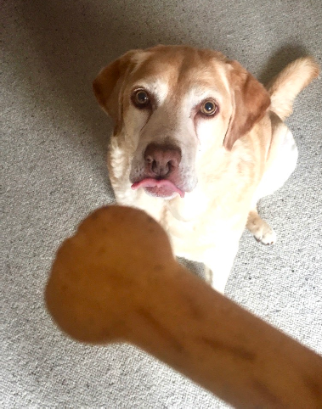
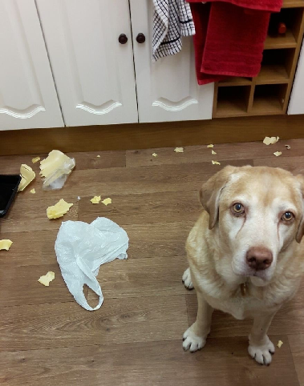
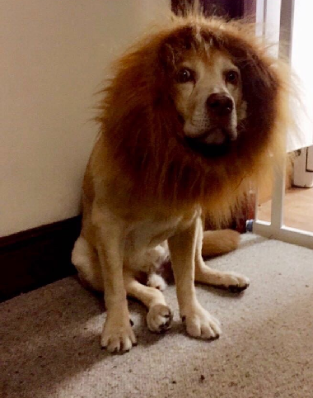
Reinforcement learning in the real world
Reward positive behavior
Don’t reward negative behavior
The result!

Slide 13






Reinforcement learning terms
Agent
Environment State Action Reward
The reward function incentivises particular behaviors and is at the core of reinforcement learning
Episode

Slide 14
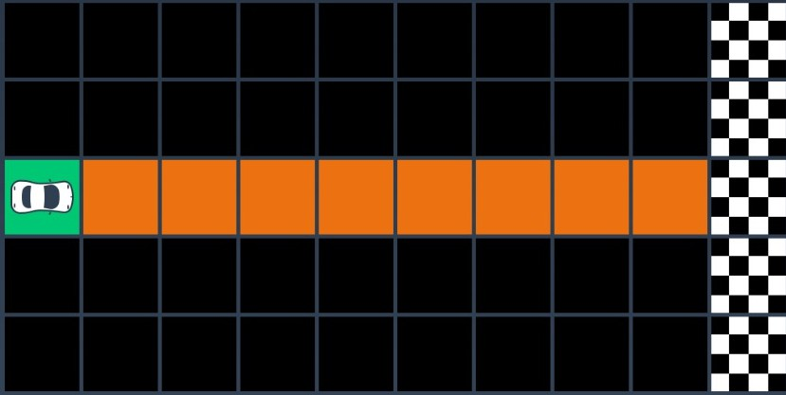


The reward function in a grid race
Agent
Goal

Slide 15
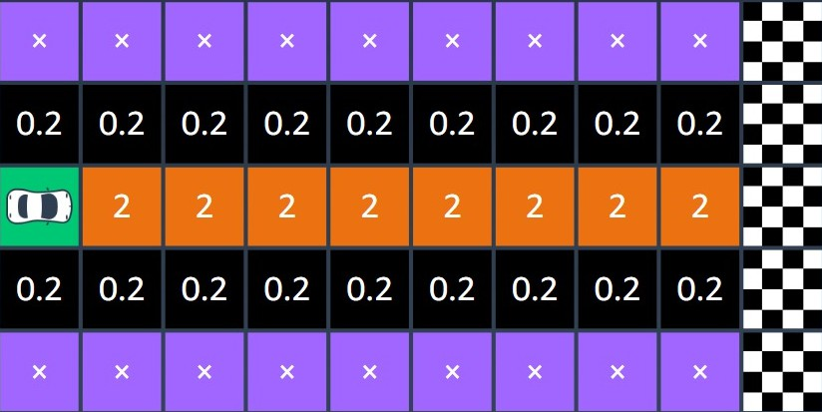
Rewards that incentivize center-line driving

Slide 16
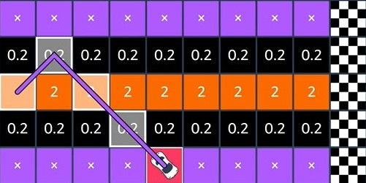

Iteration and convergence

Slide 17
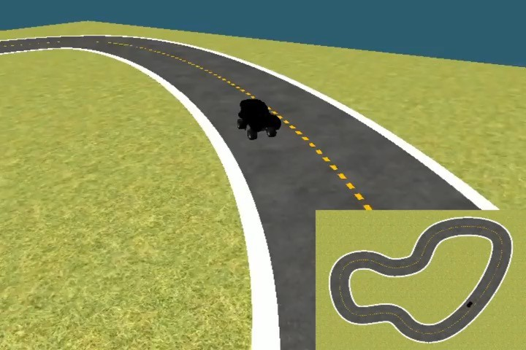
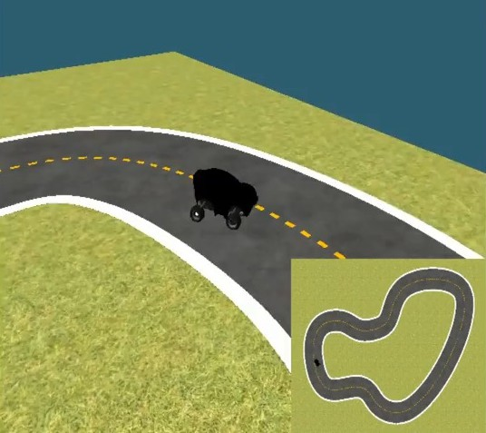
Exploration vs. Exploitation
EXPLORATION
EXPLOITATION

Slide 18
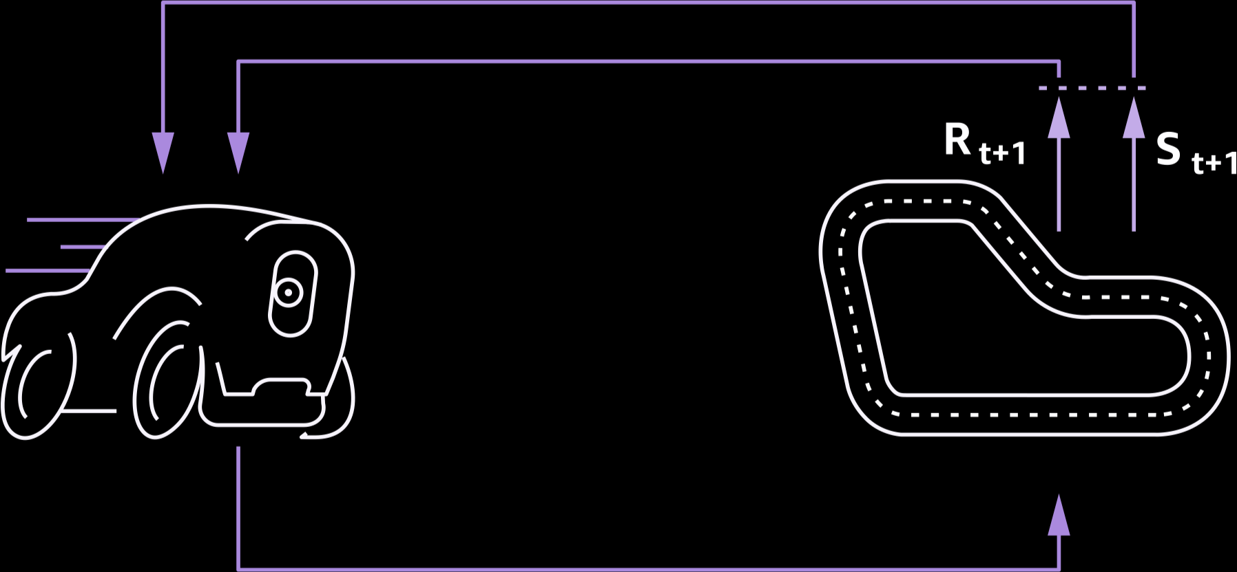
How does learning happen?
State
Reward
=
Model
Action

Slide 19

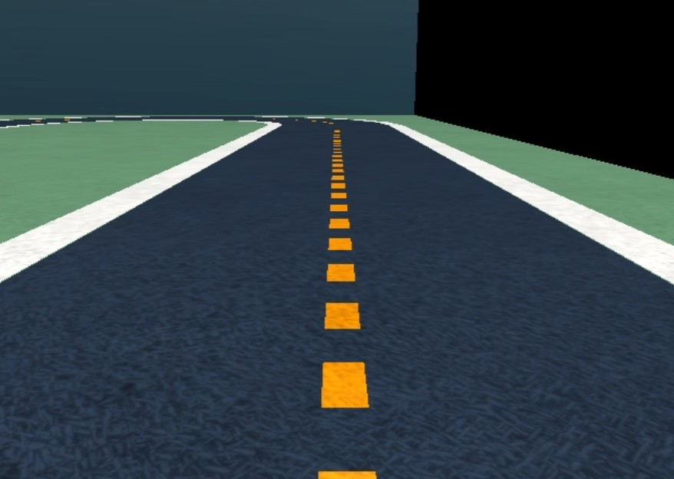
AWS DeepRacer neural network architecture
Action output
Input
CNN feature extractor
Policy network

Slide 20
The AWS DeepRacer console

Slide 21












AWS DeepRacer simulator architecture
AWS Cloud
AWS DeepRacer
Amazon SageMaker
Amazon CloudWatch
AWS
DeepRacer
Amazon S3
AWS
RoboMaker
Amazon Kinesis Video Streams

Slide 22
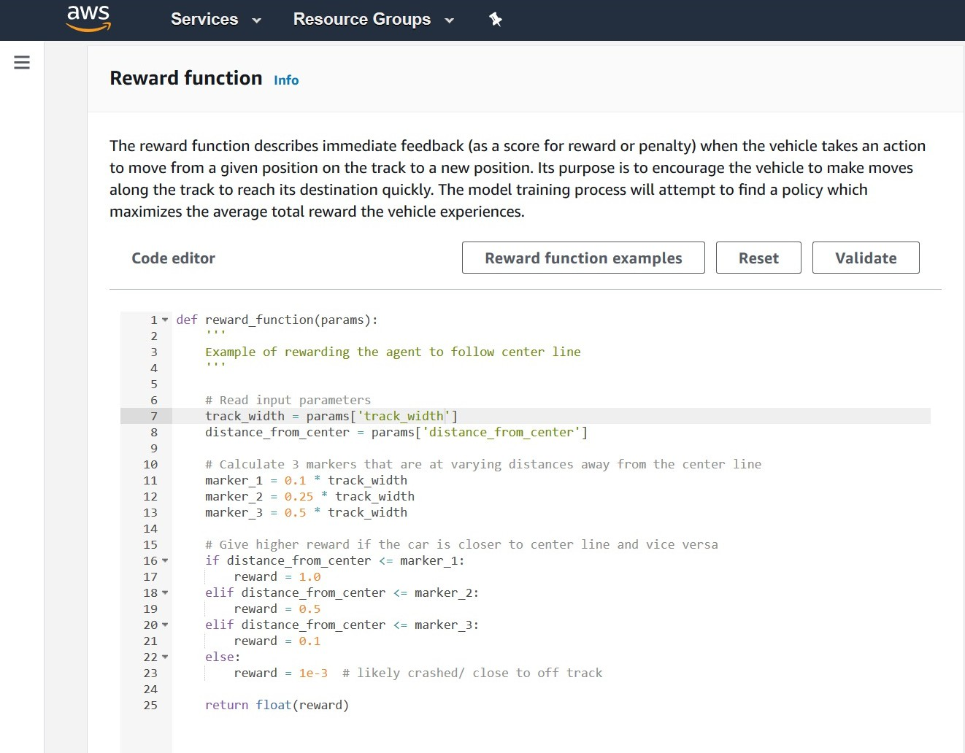


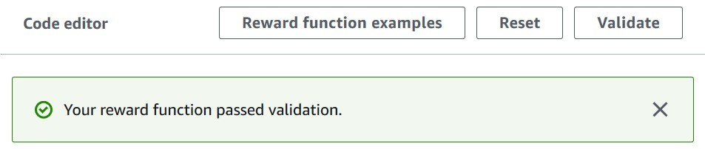
Programming your own reward function
Code editor – Python 3 syntax
Three example reward functions
Code validation via AWS Lambda

Slide 23
Using Python Libraries
Libraries Available:
math
random
numpy
scipy
shapely

Slide 24
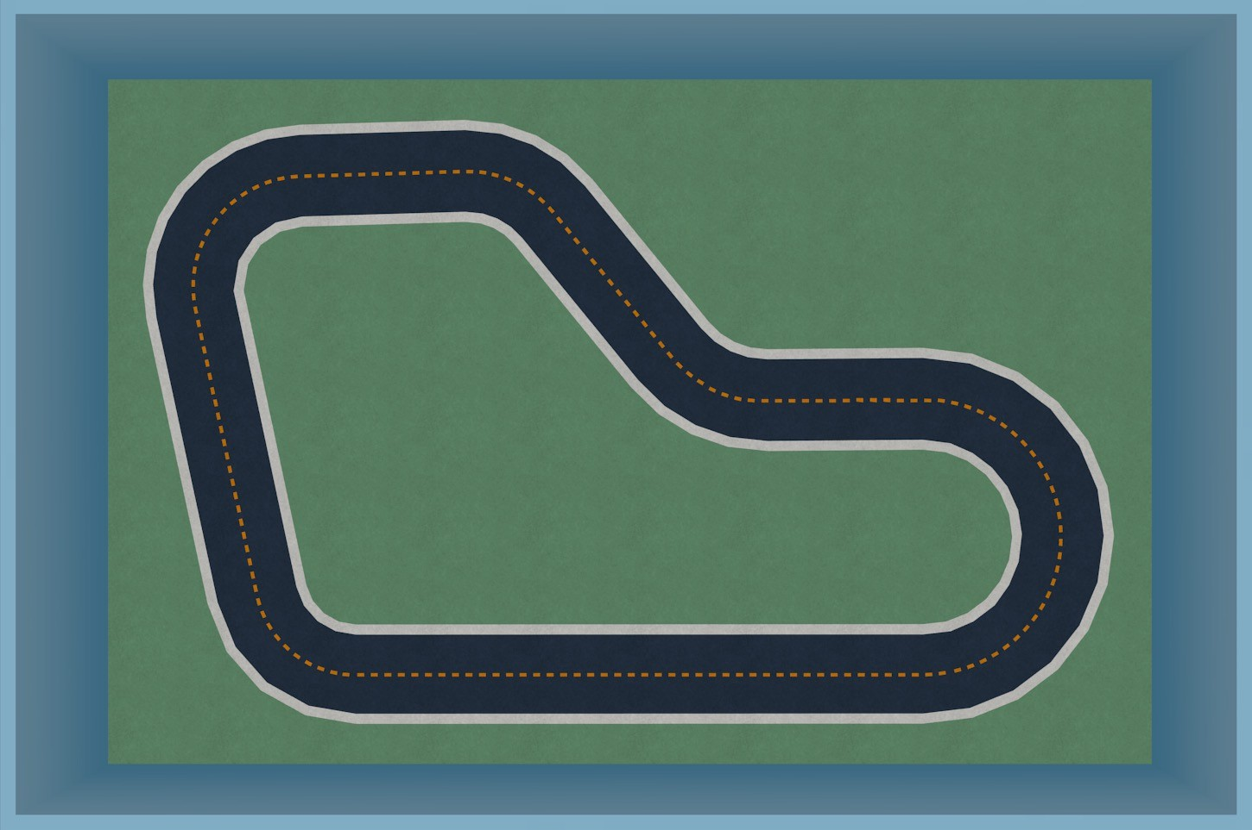
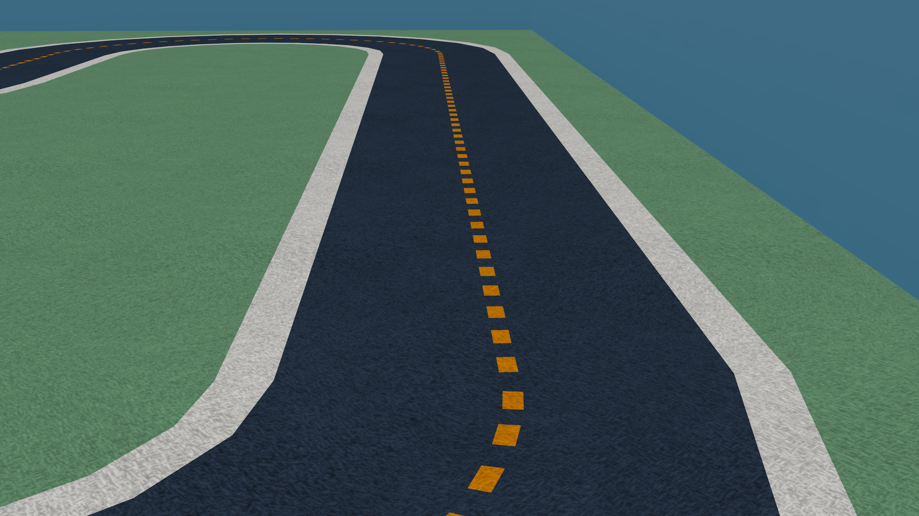
Track Components
Track wall
Field aka off-track
Track surface aka on-track
Track boundaries Track center

Slide 25

Reward function parameters
all_wheels_on_track x, y closest_objects closest_waypoints distance_from_center is_crashed is_left_of_center is_offtrack is_reversed
heading objects_distance
objects_heading objects_left_of_center objects_location objects_speed
progress speed
steering_angle steps track_length track_width Waypoints
Standard parameters EVO specific parameters
https://docs.aws.amazon.com/deepracer/latest/developerguide/deepracer- r©e2w021a, Armdaz-onfuWenb Scetrviicoes,nInc.-ionr itps Auffitlia.thes.tml

Slide 26
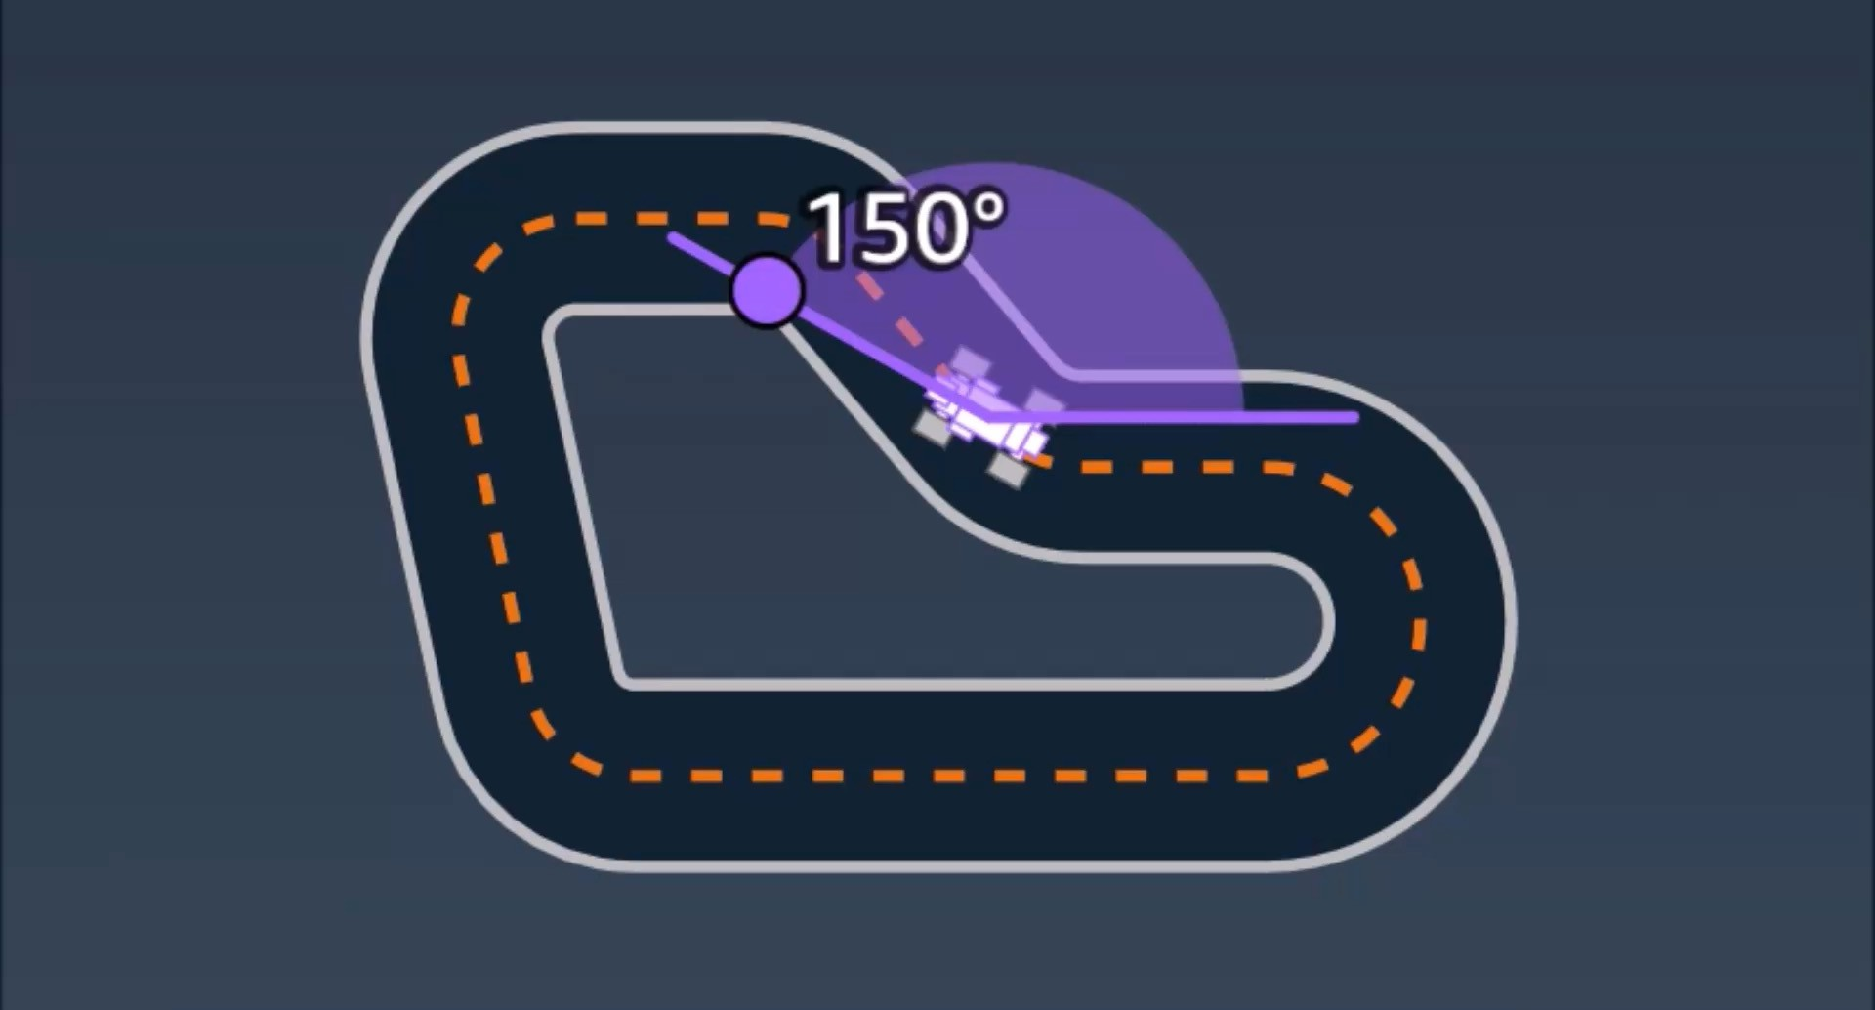
Example parameter – heading

Slide 27
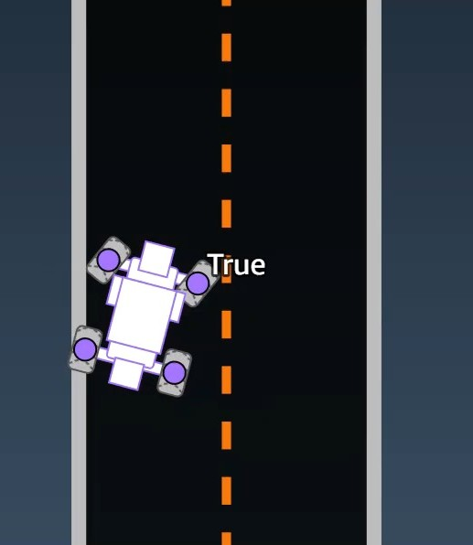
Example parameter – all_wheels_on_track

Slide 28
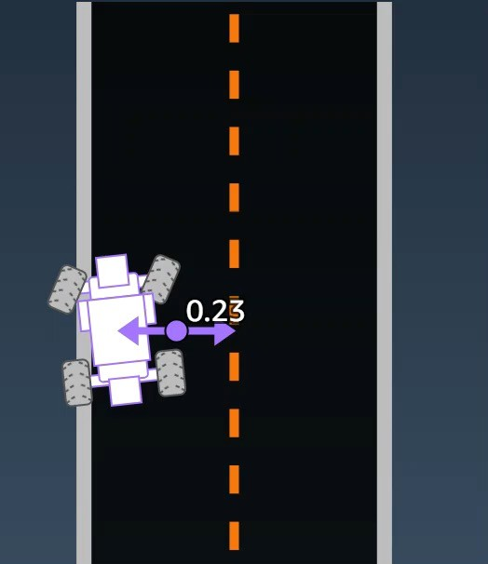
Example parameter – distance_from_center

Slide 29
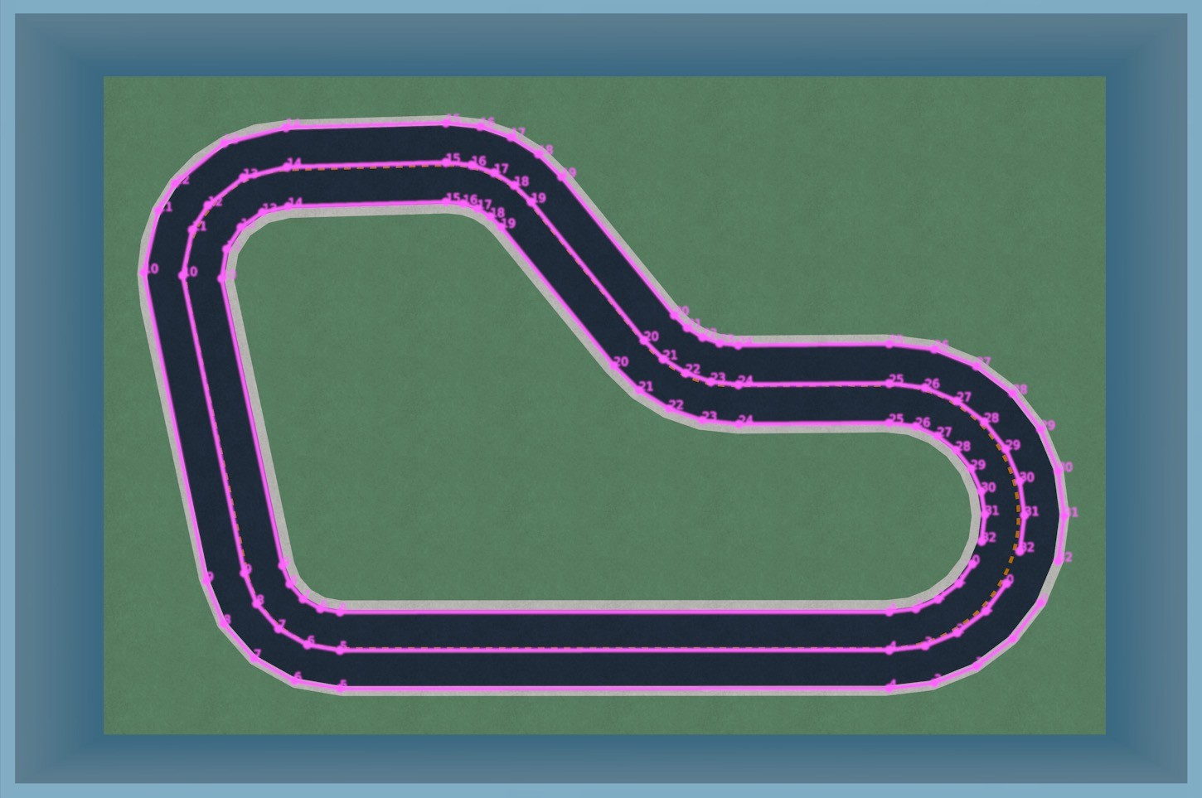
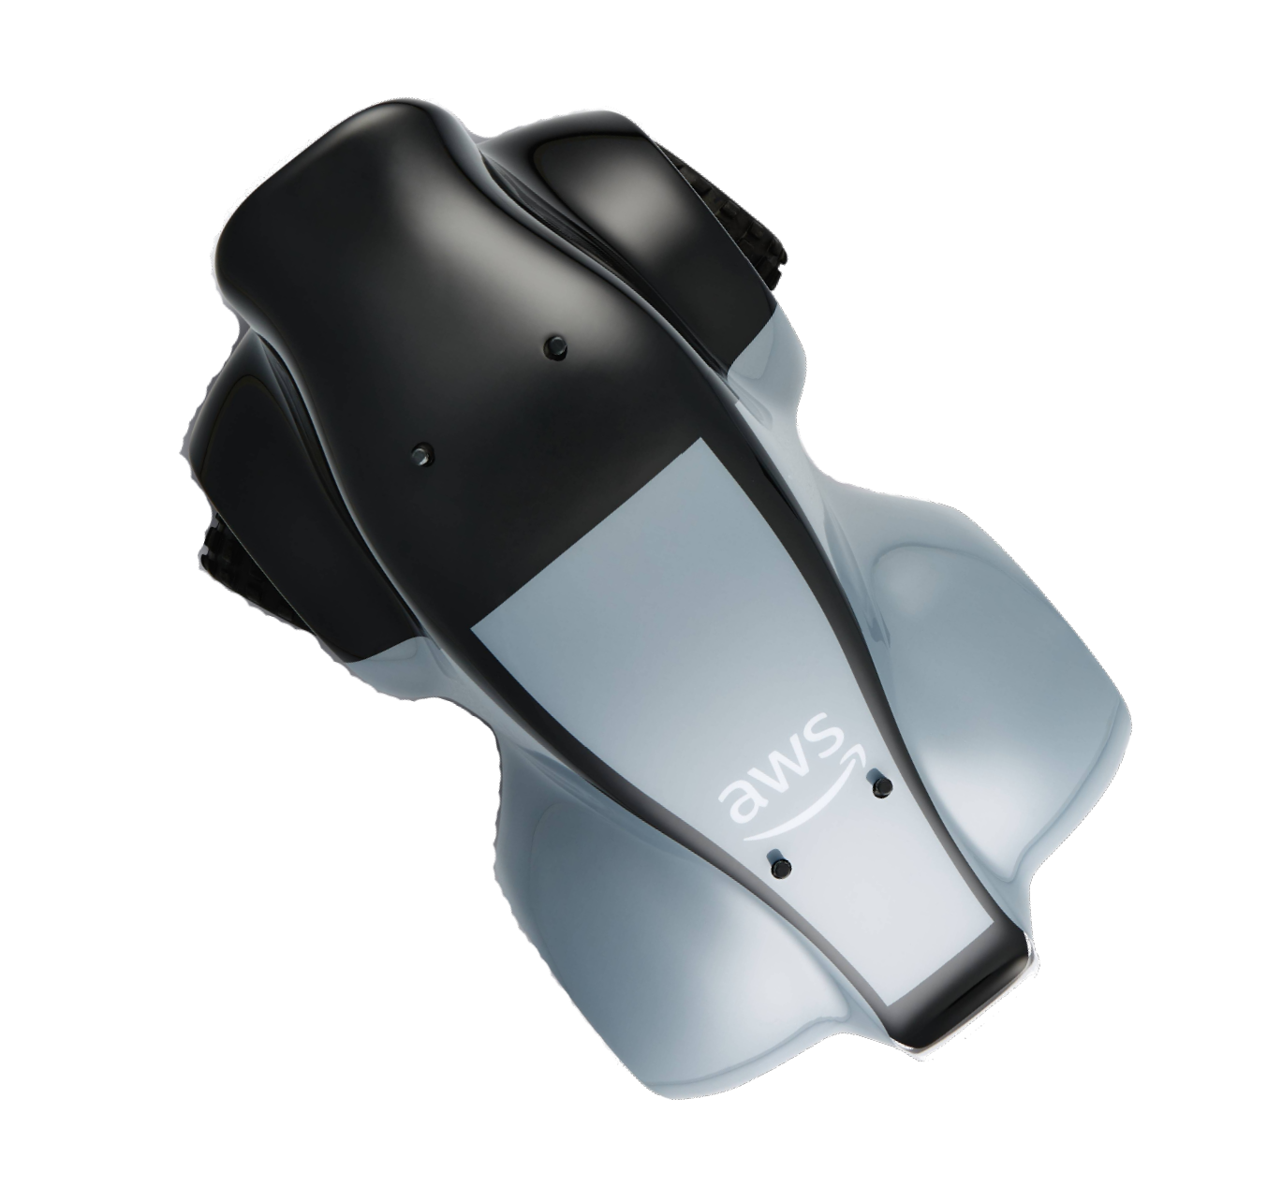


Coordinate system and track waypoints
Heading
Y
Track width
Waypoints
X

Slide 30
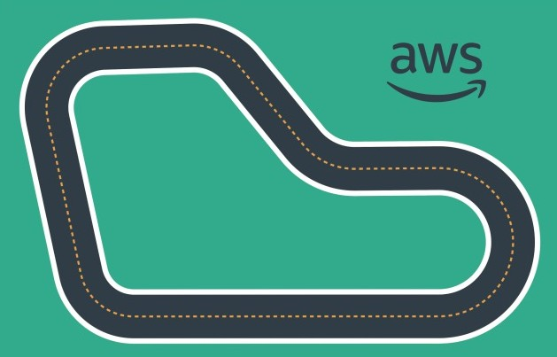
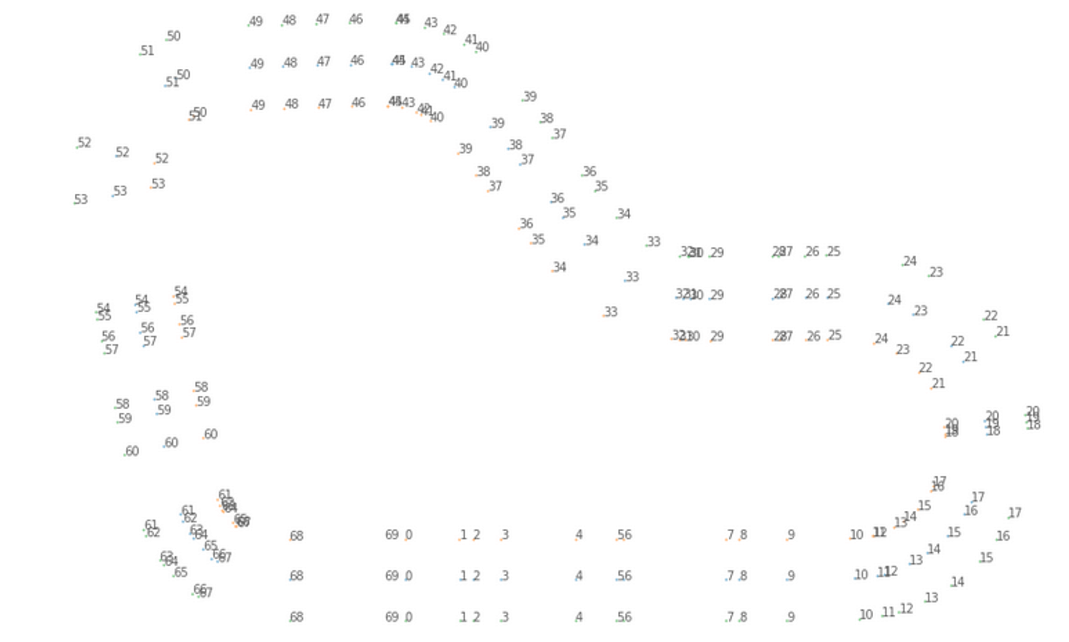
Useful input parameter: Waypoints
An ordered list of track-dependent milestones along the track center
Let you set different criteria at different positions

Slide 31
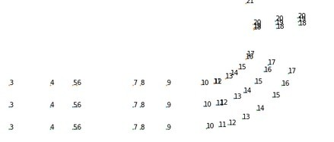
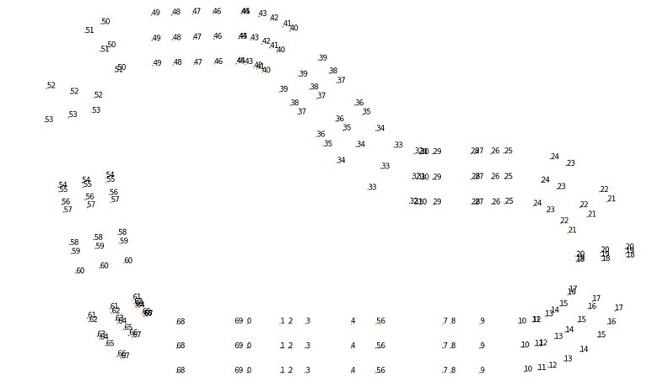
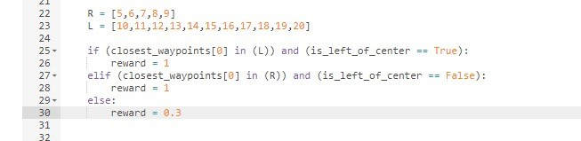
Using waypoints to reward different behavior

Slide 32
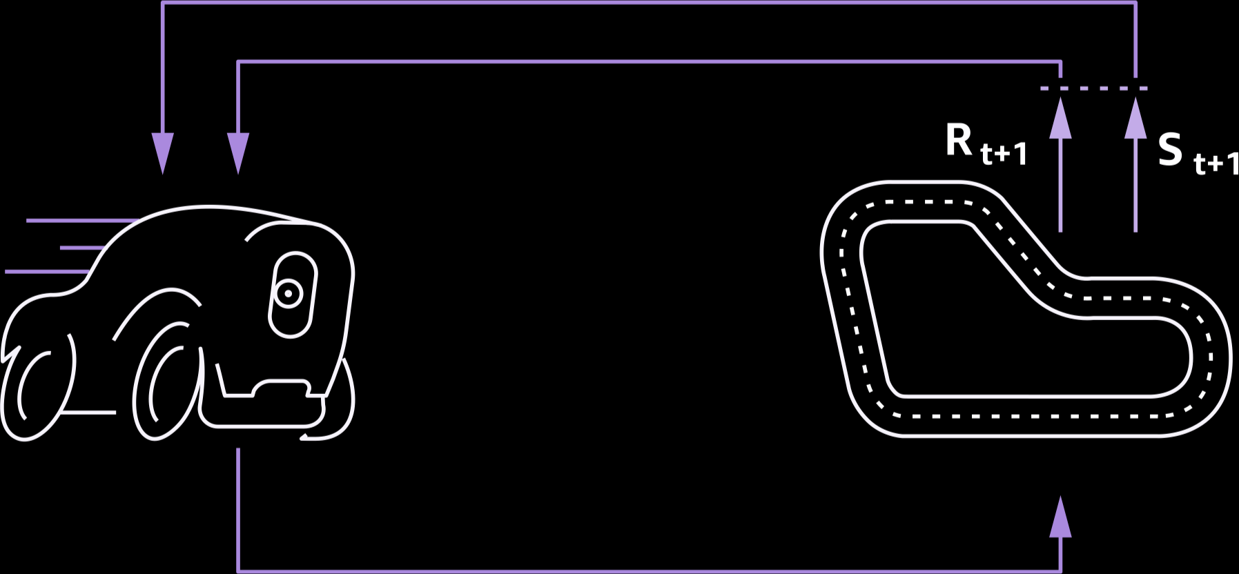
Useful input parameter: Steps
State
Number of steps completed; will be reset when off track
Easy way to improve the finish time
Action

Slide 33
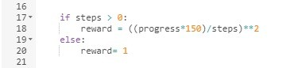
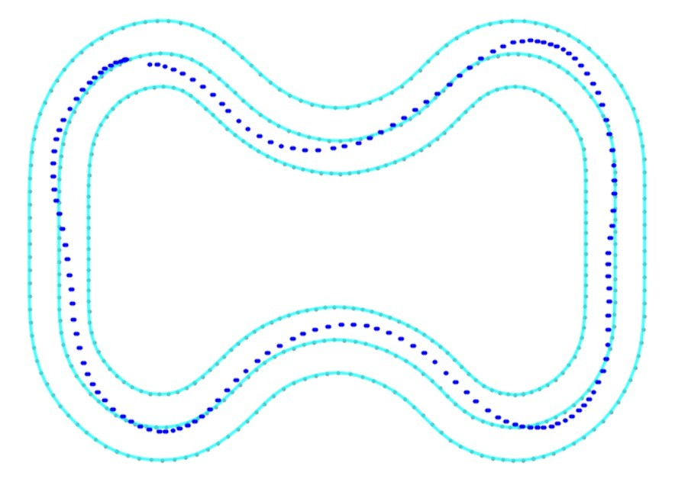
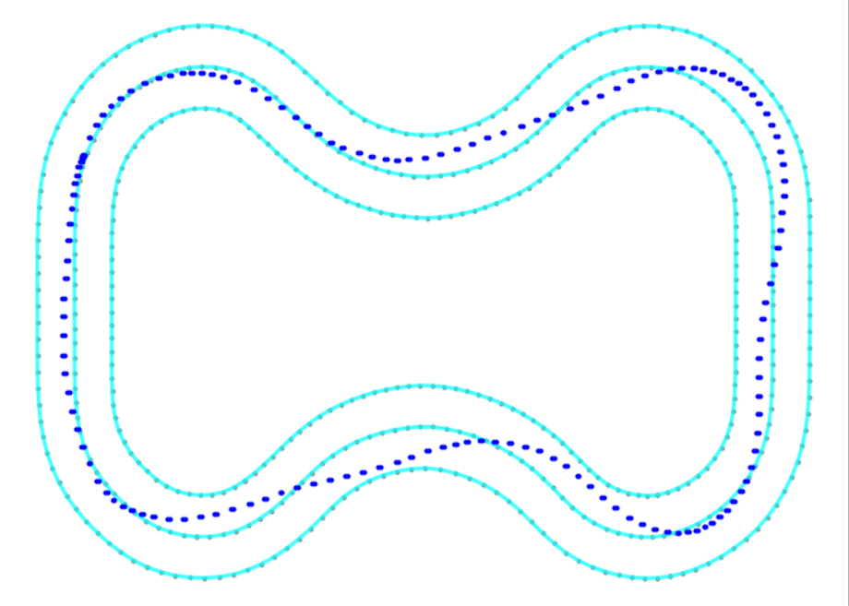
Comparison and sample code

Slide 34
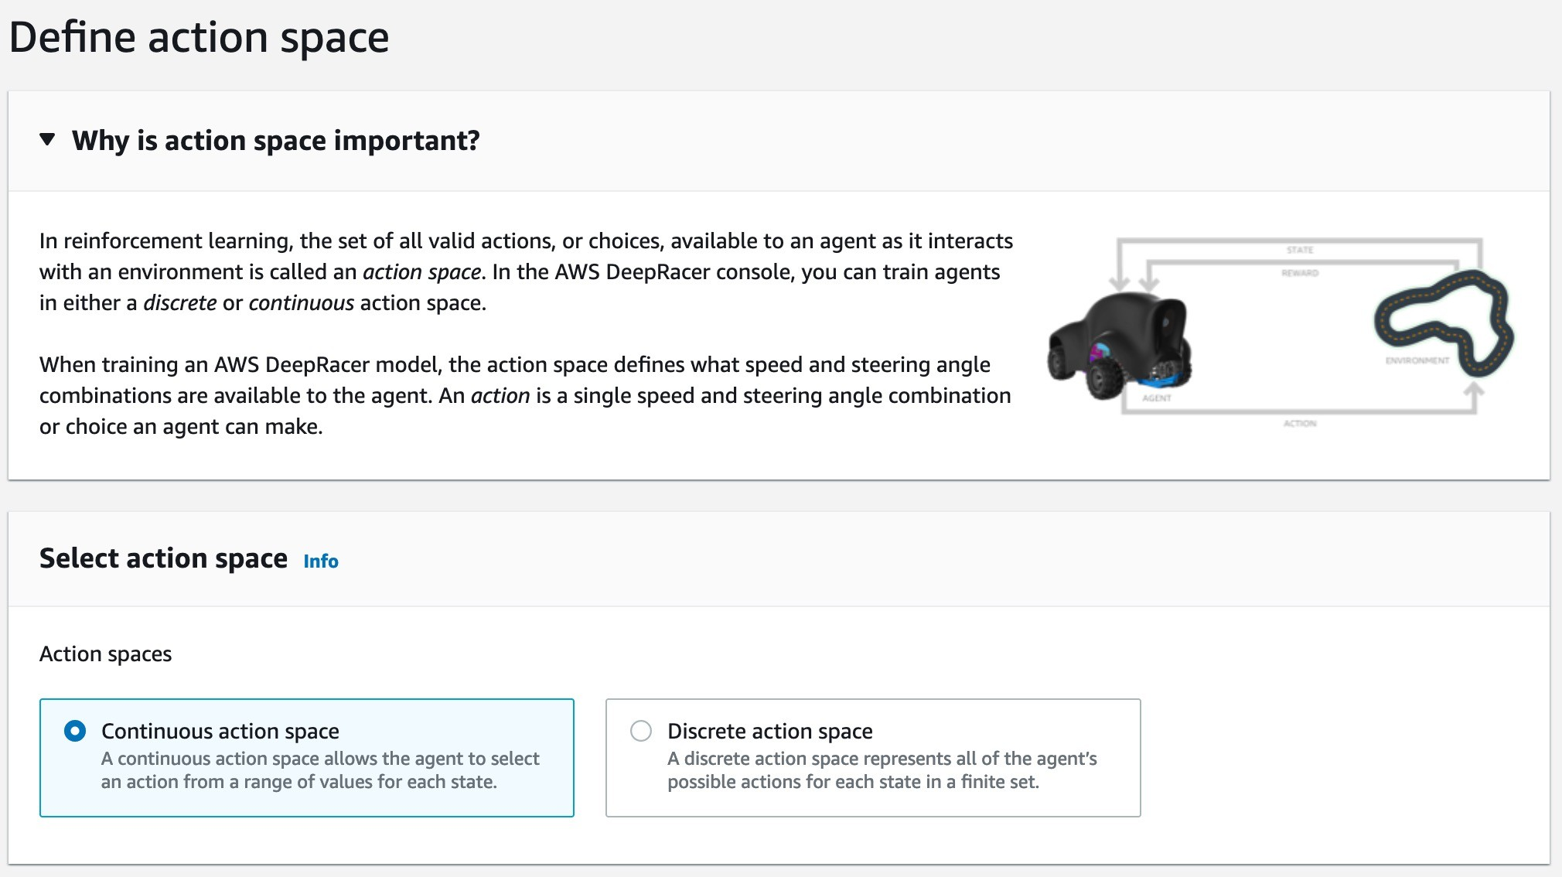

Action space

Slide 35
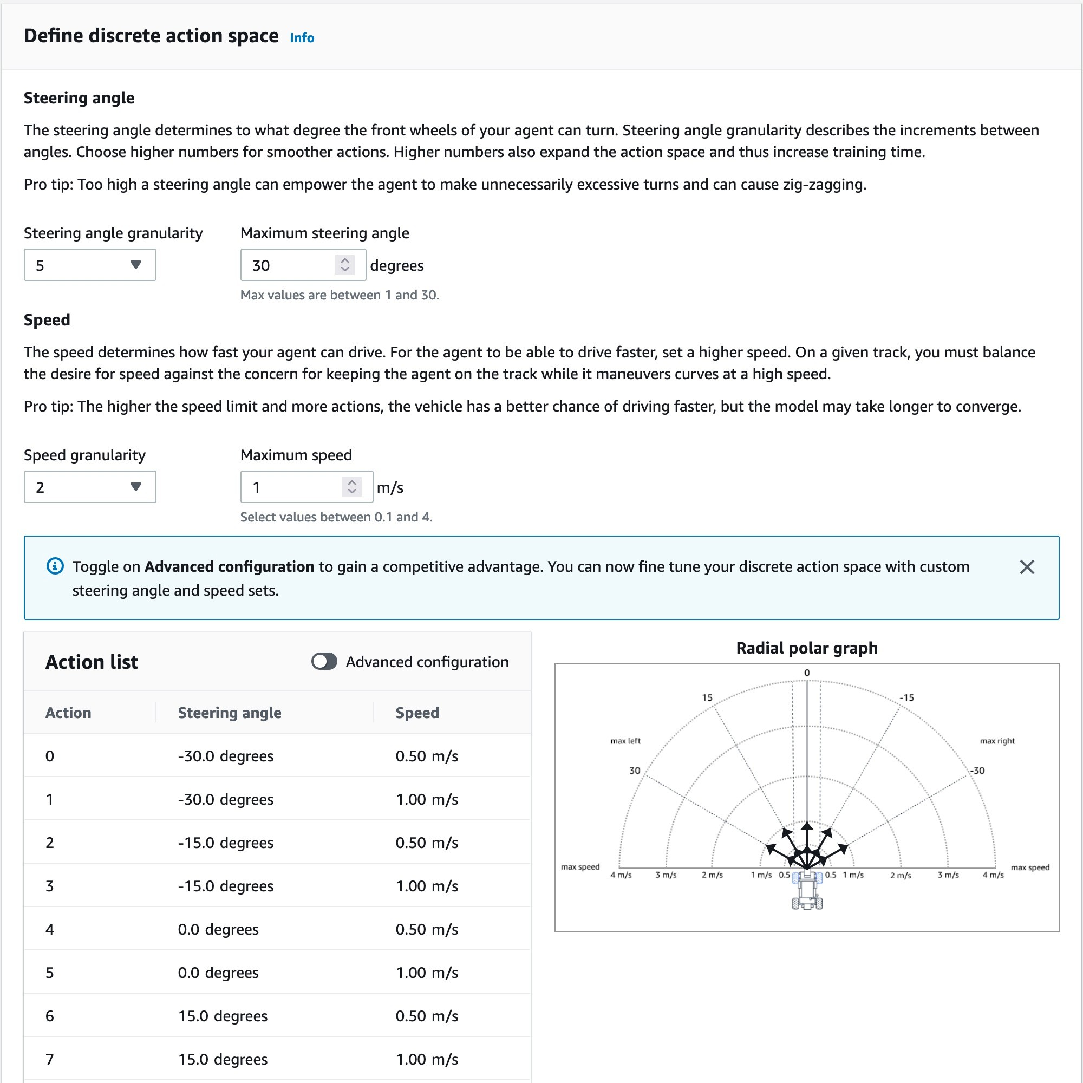
Discrete Action space

Slide 36
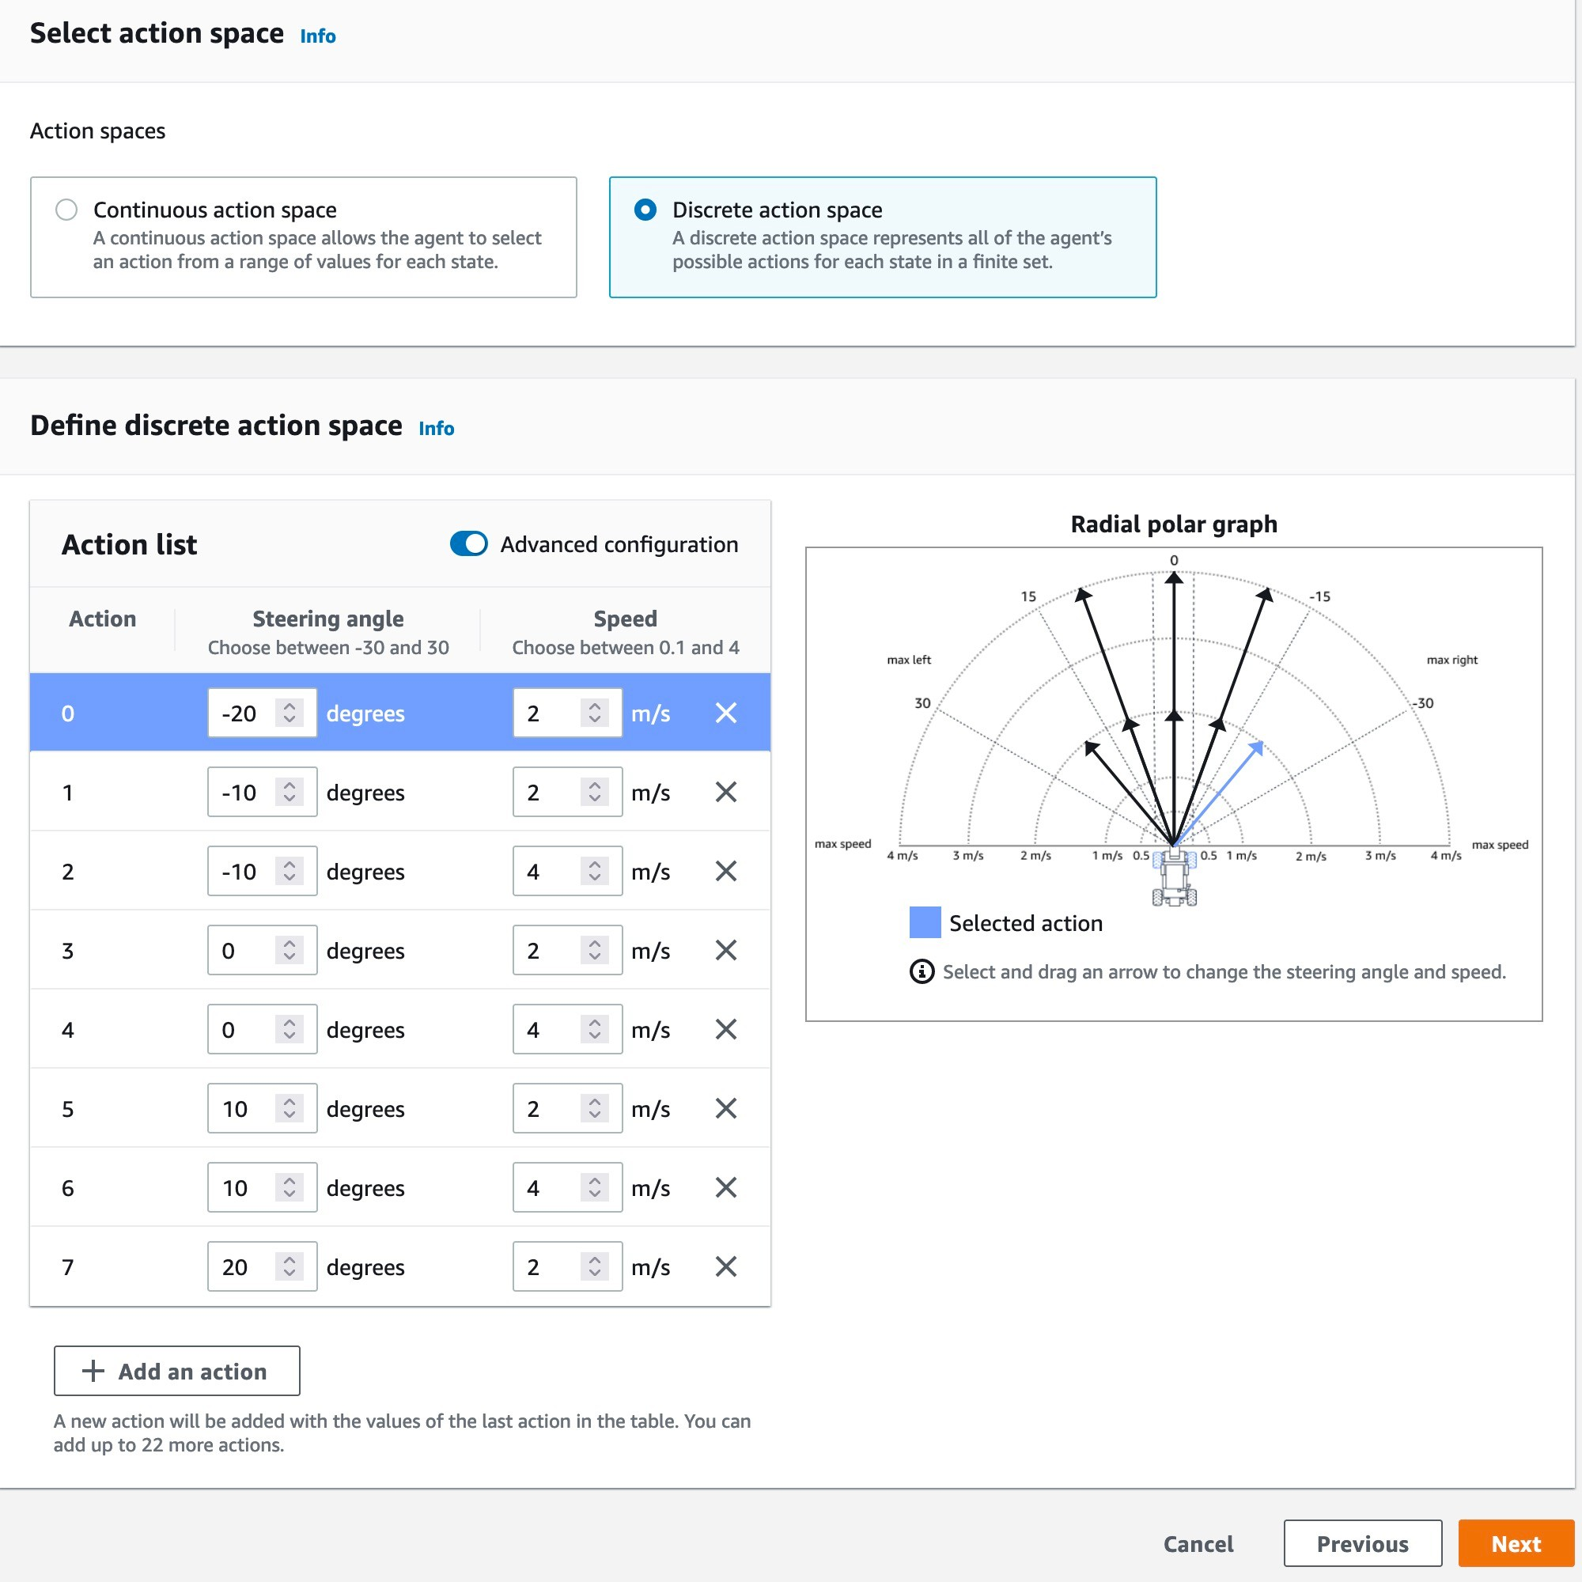
Discrete Action space

Slide 37
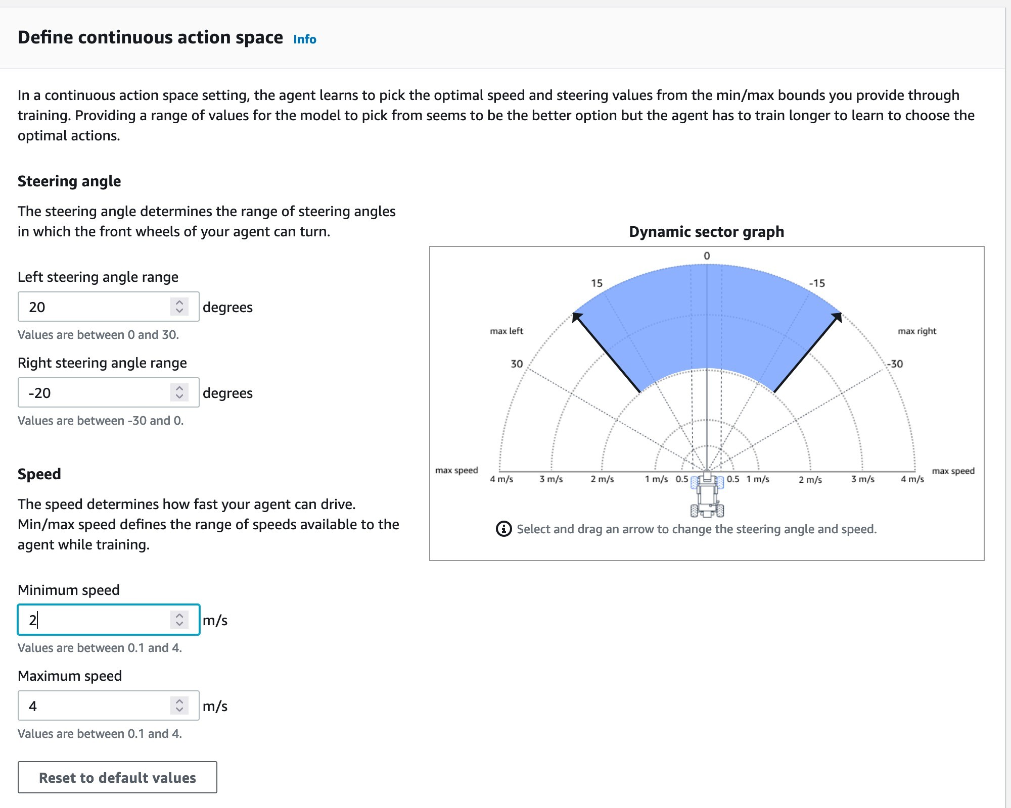
Continuous Action space

Slide 38
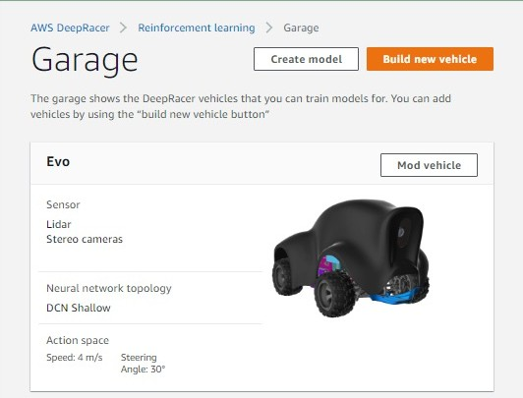
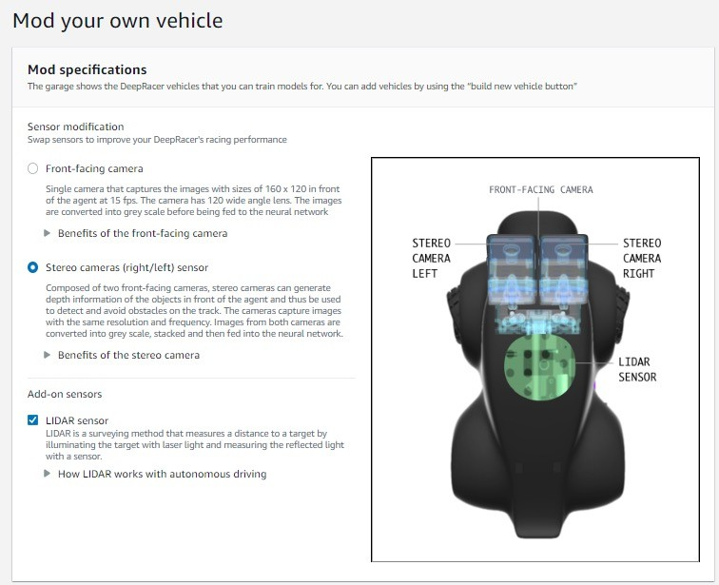
Customize your agent’s sensors in the Garage

Slide 39
Going hands on

Slide 40
Training observation

Slide 41
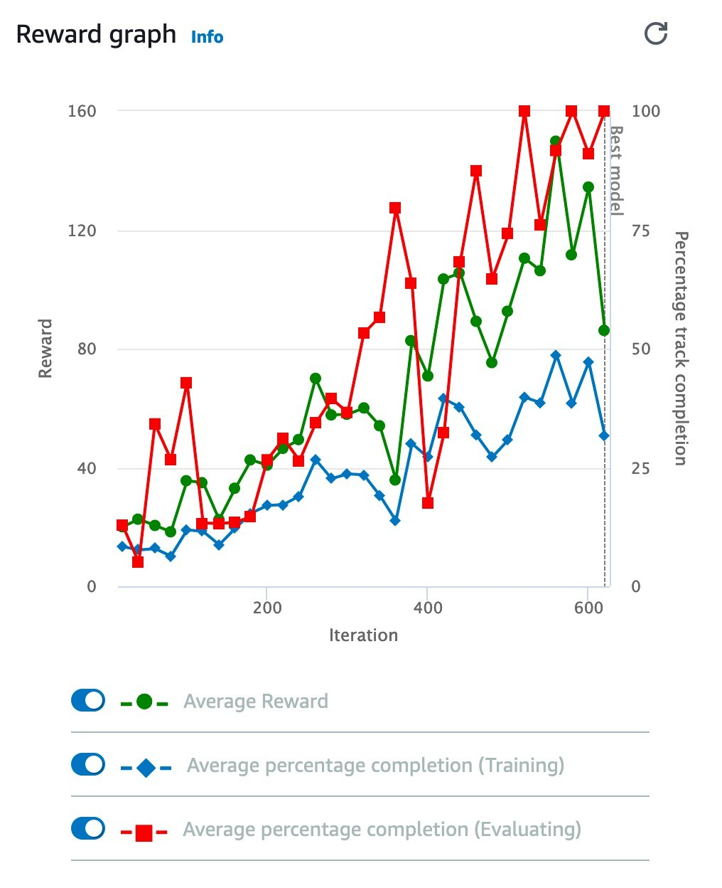
Do you need more training time?

Slide 42
Why are the training and evaluation lines separate?

Slide 43
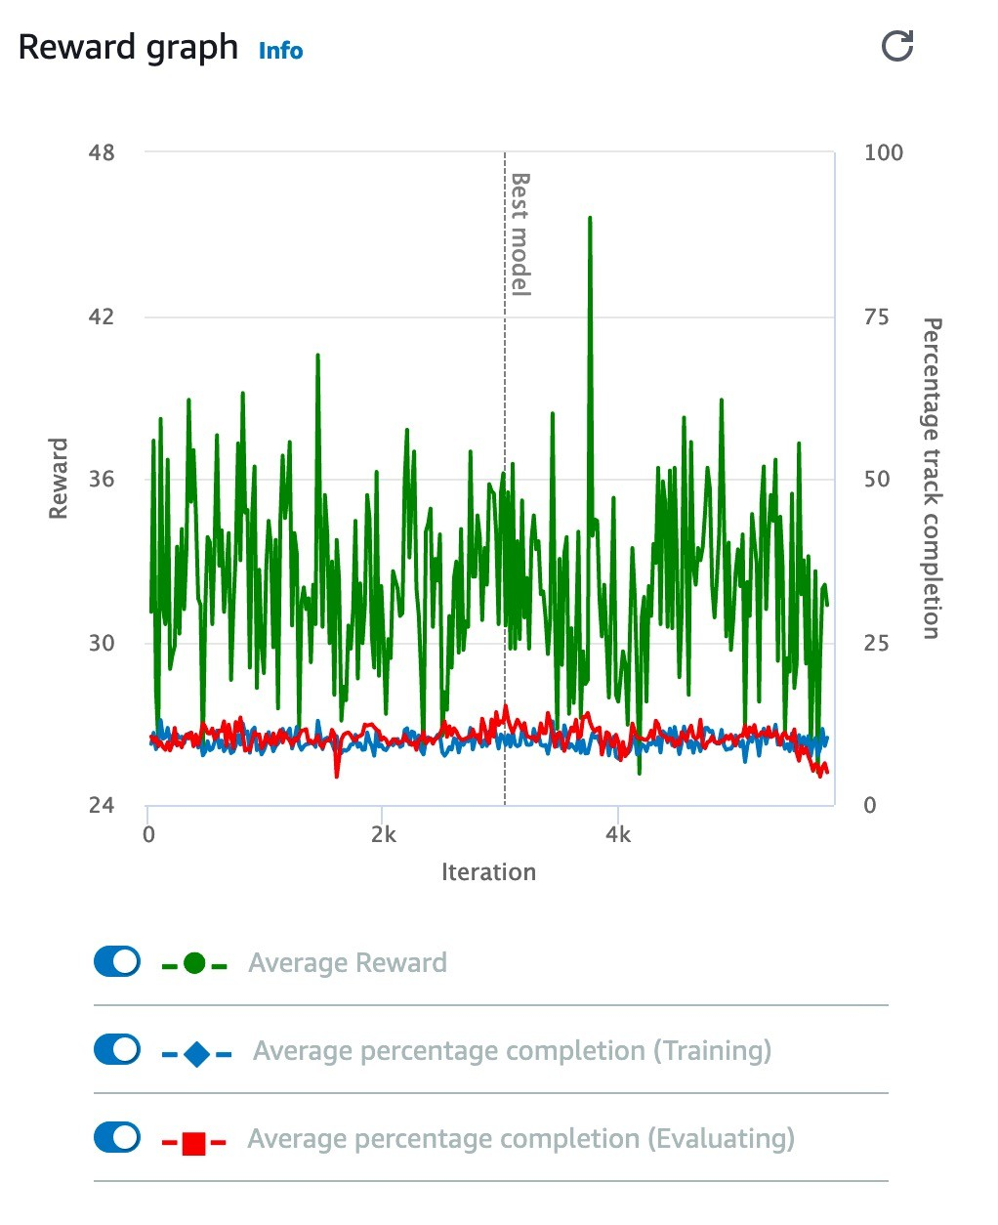
Is training not improving?

Slide 44
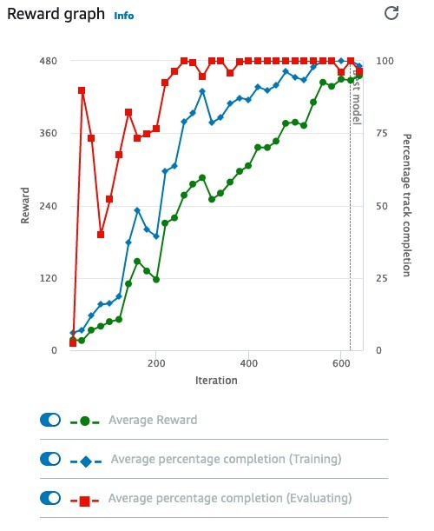
Are you overfitting?

Slide 45
Additional resources
AWS DeepRacer Slack community http://join.deepracing.io/
GitHub
https://github.com/aws-samples/aws-deepracer-workshops/ Free video course
https://www.aws.training/Details/eLearning?id=32143
Tips
https://aws.amazon.com/deepracer/racing-tips/ Reward function parameters
https://docs.aws.amazon.com/deepracer/latest/developerguide/deepracer- reward-function-input.html

Slide 46
Thank you

